Slide 1
Principle component analysis
One of many sub-space methods

Slide 2
Principal Component Analysis
PCA is exploartory:
  No model – the data is not linked to a response
  Explore strucutre in the data
  Outlier detection
  Dimensional reduction
PCA uses the properties of high dimensional data
  Data is clusted in space
  Data lie on a low dimensional mainfold
  Variables are correlated

Slide 3
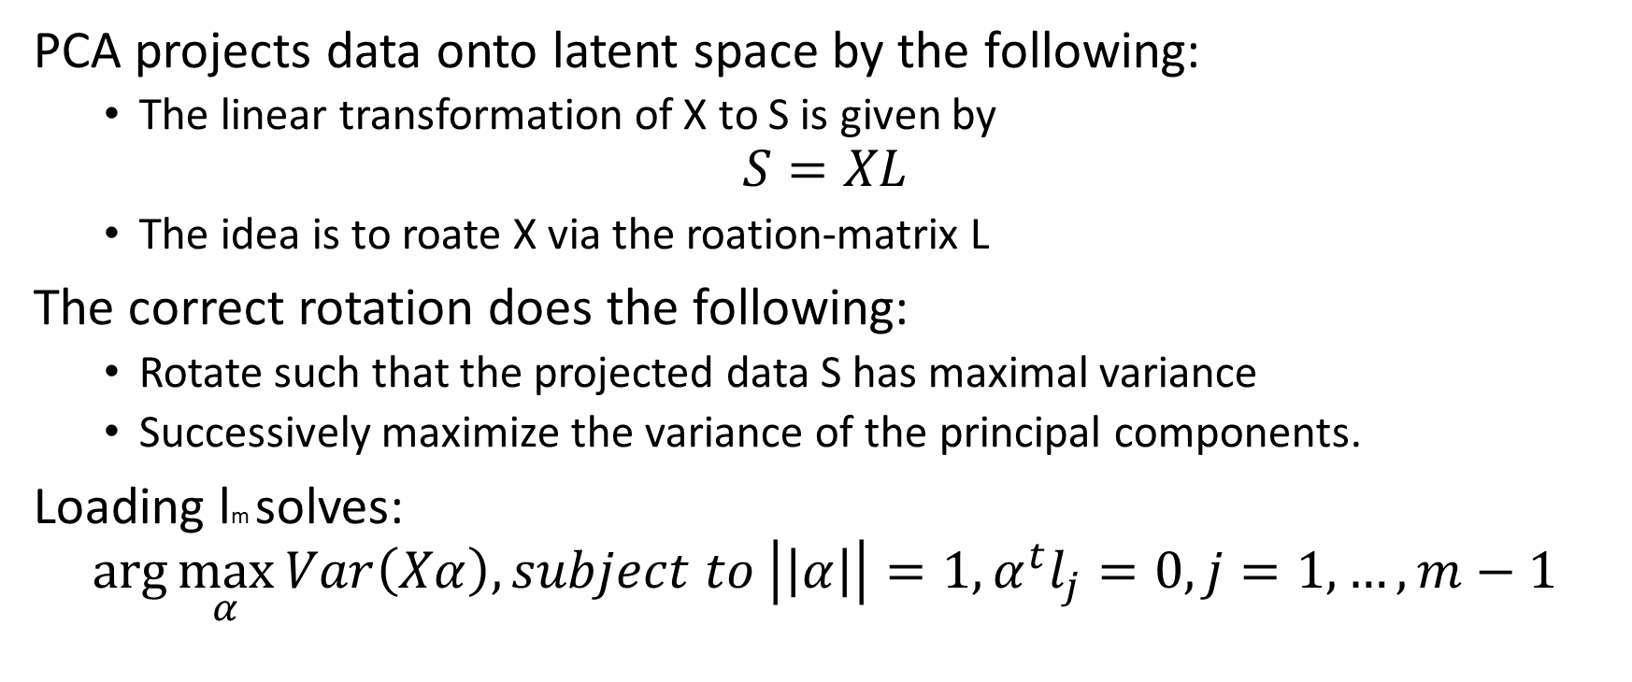
PCA – from full space to latent space
PCA projects data onto latent space by the following:
  The linear transformation of X to S is given by
$$S=XL$$
  The idea is to roate X via the roation-matrix L
The correct rotation does the following:
  Rotate such that the projected data S has maximal variance
  Successively maximize the variance of the principal components.
Loading lm solves:
$$\arg{\max_{α}{Var\left(Xα\right), subject to \left|\left|α\right|\right|=1, α^{t}l_{j}=0, j=1,…,m−1}}$$

Slide 4
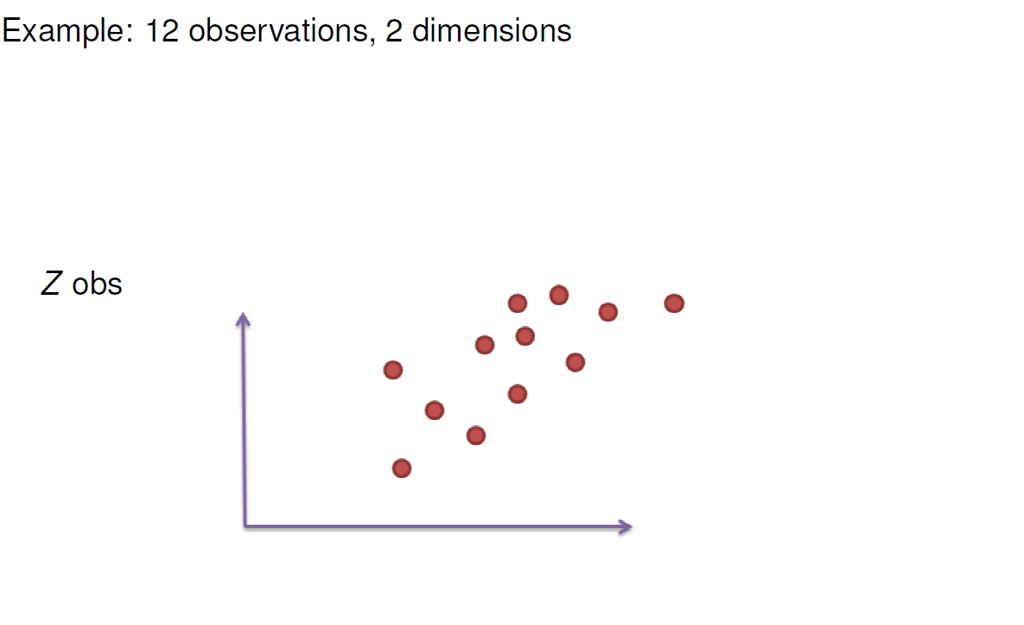
PCA – from full space to latent space

Slide 5
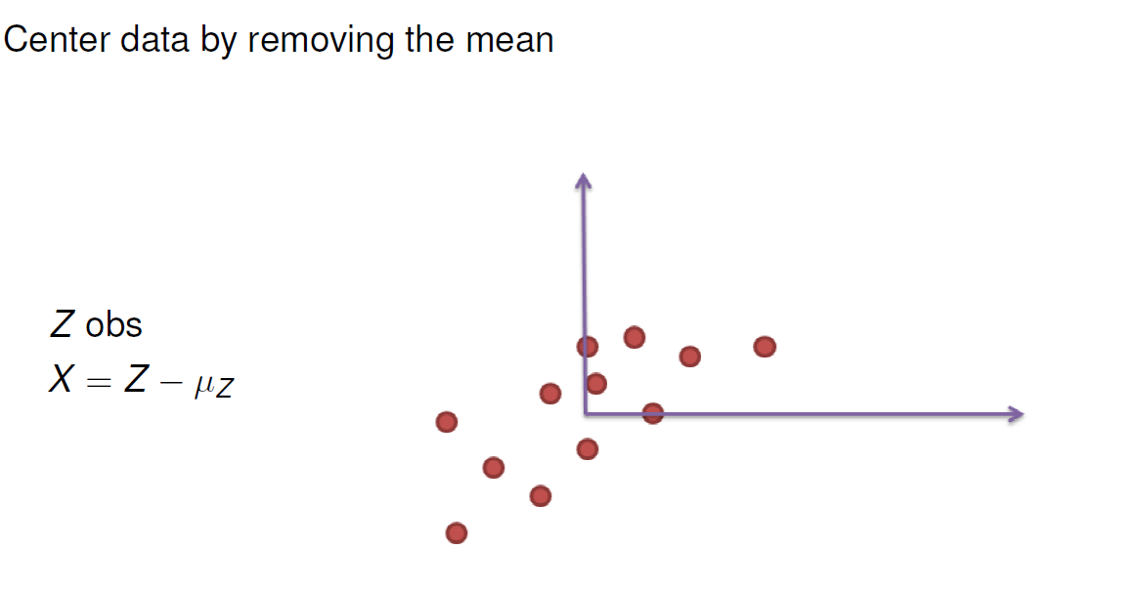
PCA from full space to latent space

Slide 6
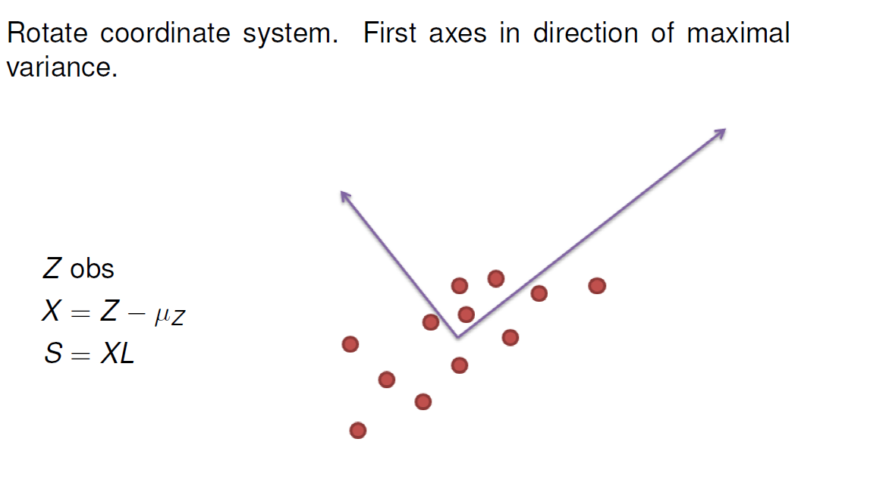
PCA from full space to latent space

Slide 7
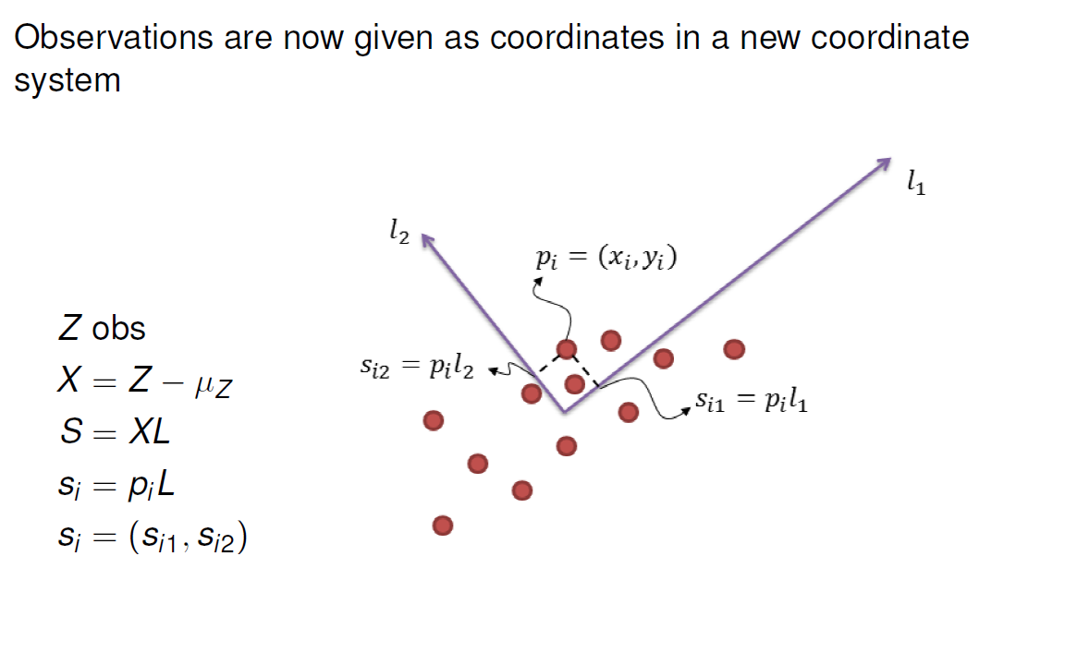
PCA from full space to latent space

Slide 8
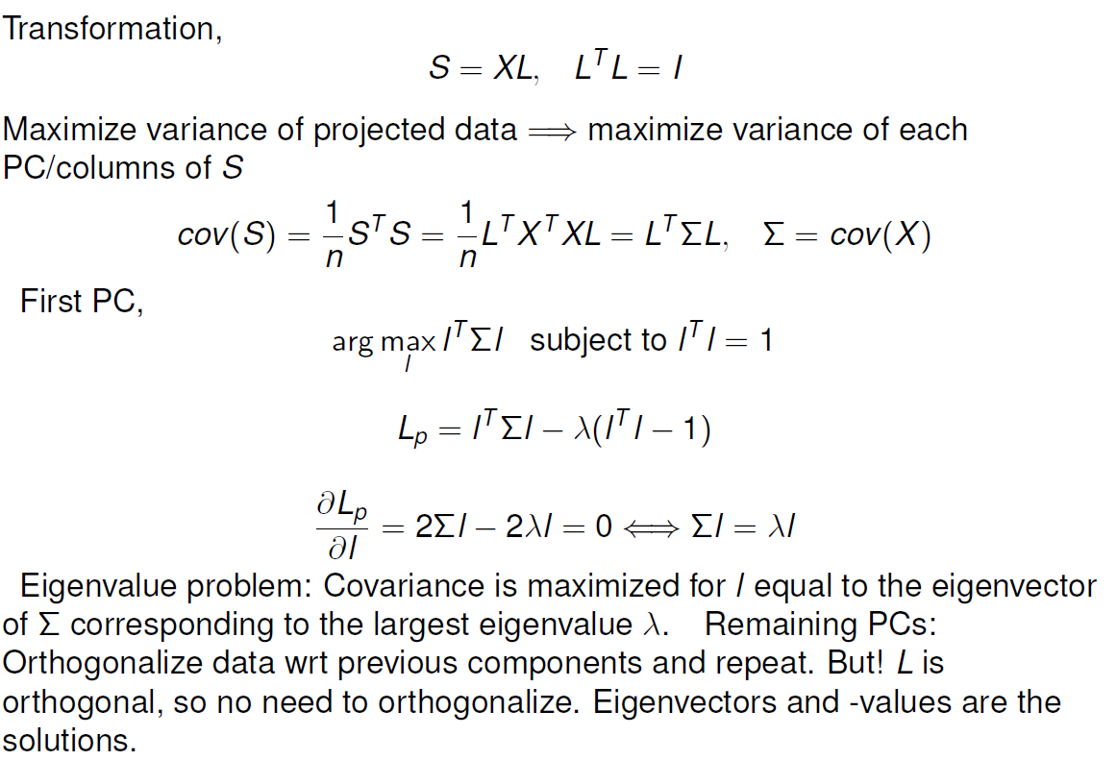
PCA derivation

Slide 9
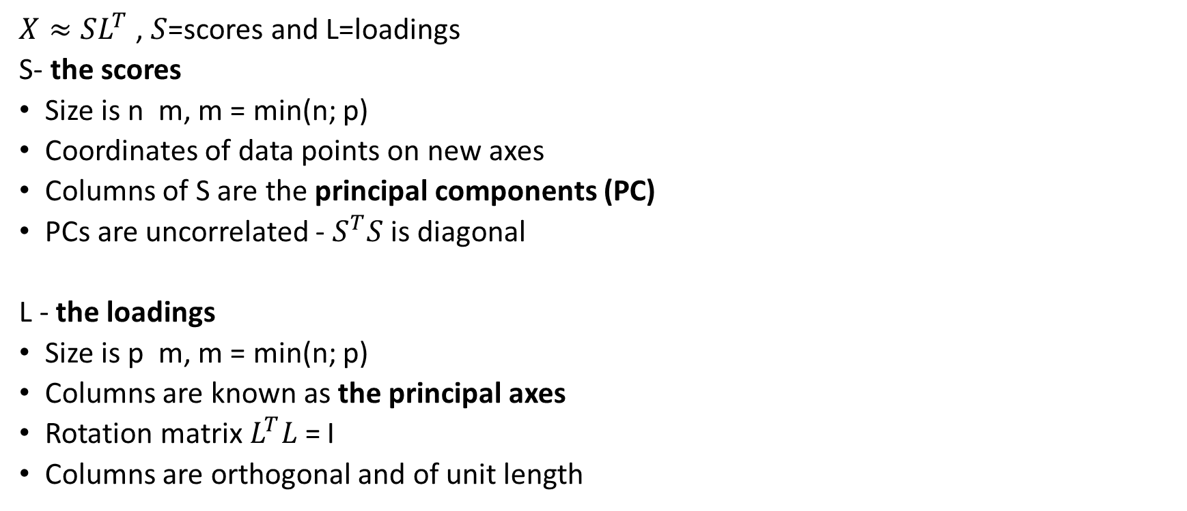
Scores and loadings
$X≈SL^{T}$ , $S$=scores and L=loadings
S- the scores
Size is n m, m = min(n; p)
Coordinates of data points on new axes
Columns of S are the principal components (PC)
PCs are uncorrelated - $S^{T}S$ is diagonal
L - the loadings
Size is p m, m = min(n; p)
Columns are known as the principal axes
Rotation matrix$L^{T}L$= I
Columns are orthogonal and of unit length

Slide 10
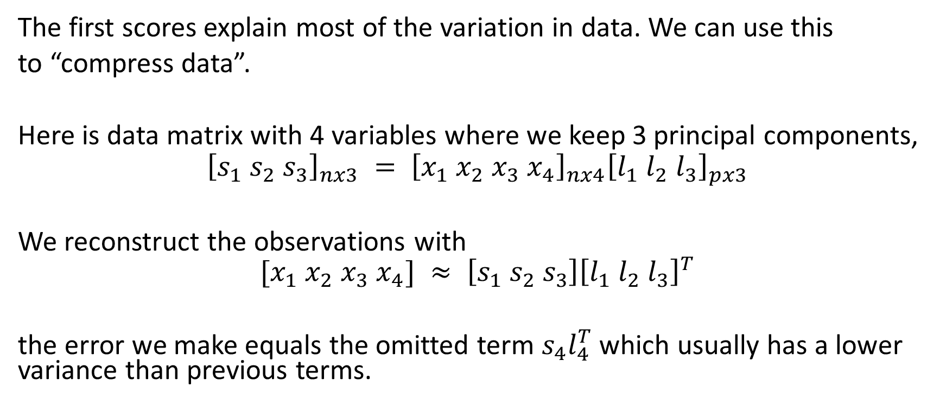
Dimensional reduction
The first scores explain most of the variation in data. We can use this
to “compress data”.
Here is data matrix with 4 variables where we keep 3 principal components,
$${\left[s_{1} s_{2} s_{3}\right]}_{nx3} = {\left[x_{1} x_{2} x_{3} x_{4}\right]}_{nx4}{\left[l_{1} l_{2} l_{3}\right]}_{px3}$$
We reconstruct the observations with
$$[x_{1} x_{2} x_{3} x_{4}] ≈ \left[s_{1} s_{2} s_{3}\right]{\left[l_{1} l_{2} l_{3}\right]}^{T}$$
the error we make equals the omitted term $s_{4}l_{4}^{T}$ which usually has a lower variance than previous terms.

Slide 11
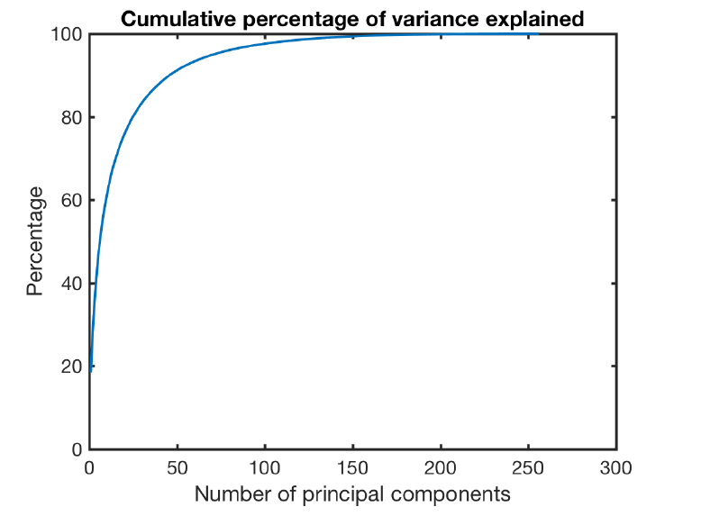
Explained varaince
The fewer PCs we keep the less of the variation in data is retained
How would you determin the number of PCs?

Slide 12
The number of components?
Obtain a certain percentage of explained variance
  Usually a bad idea!
Keep eigenvectors with eigenvalues greater than one for correlation matrix (Kaiser criterion)
The heuristic method of elbow plot (scree-plot)

Slide 13
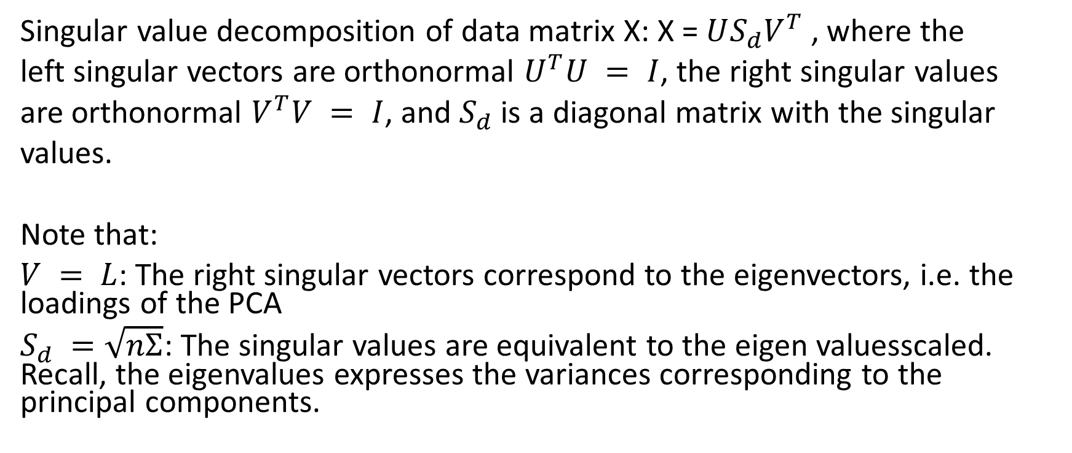
PCA:An easy way to compute via SVD
Singular value decomposition of data matrix X: X = $US_{d}V^{T}$ , where the
left singular vectors are orthonormal $U^{T}U = I$, the right singular values
are orthonormal $V^{T}V = I$, and $S_{d}$ is a diagonal matrix with the singular
values.
Note that:
$V = L$: The right singular vectors correspond to the eigenvectors, i.e. the loadings of the PCA
$S_{d} =\sqrt{nΣ}$: The singular values are equivalent to the eigen valuesscaled. Recall, the eigenvalues expresses the variances corresponding to the principal components.

Slide 14
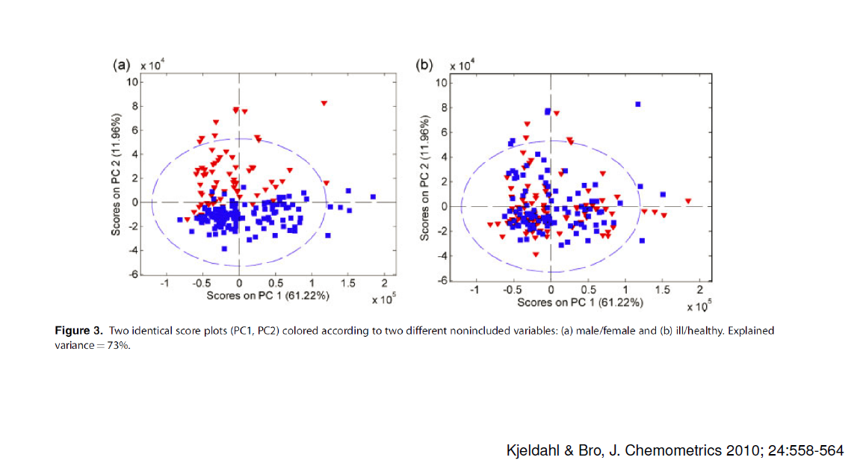
PCA: Pitfalls 1
PCA captures main variation, this is not always what is of interest!

Slide 15
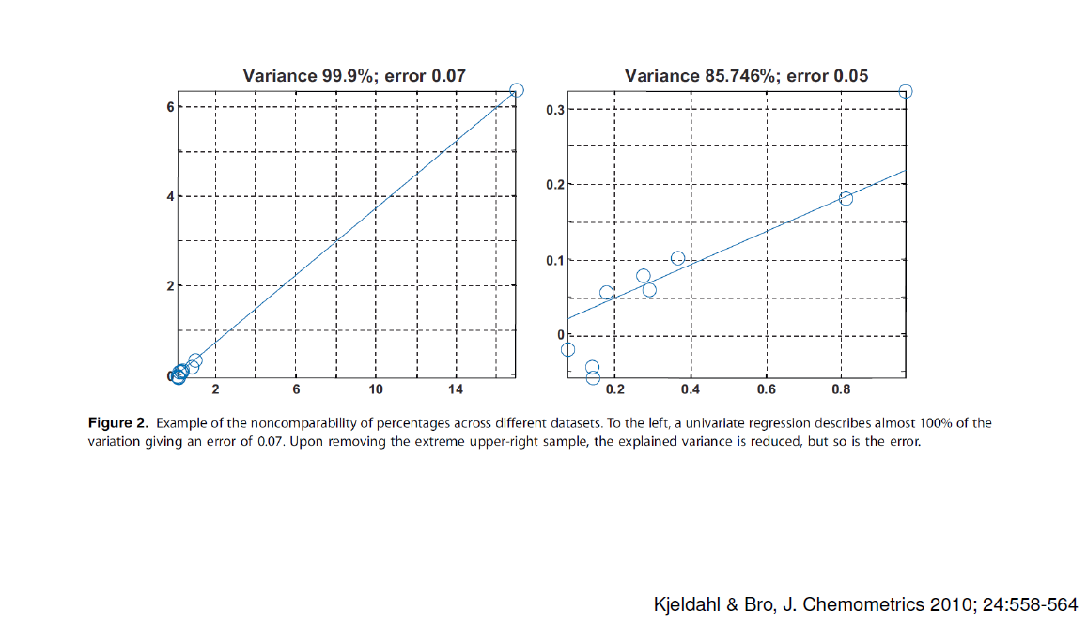
PCA: Pitfalls 2
Explained variance cannot be compared across different data!

Slide 16
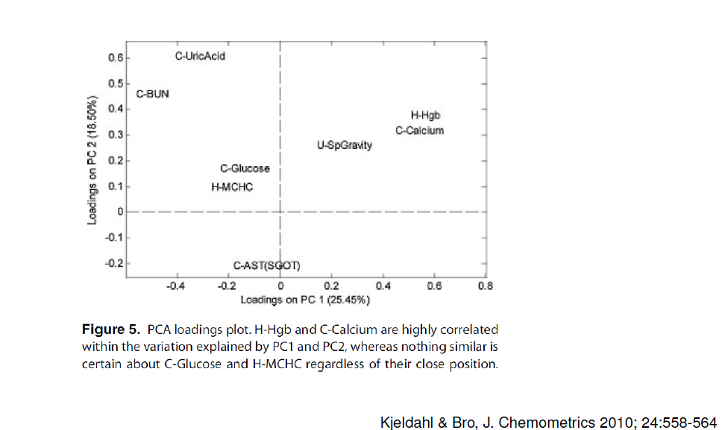
PCA: Pitfalls 3
Loadings change with scaling of variables. Use correlation loadings (standardized data) for interpretation. Variables close to each other far away from origin (0,0) are correlated. Variables close to (0,0) are not explained by the chosen principal components and not much can be concluded.

Slide 17
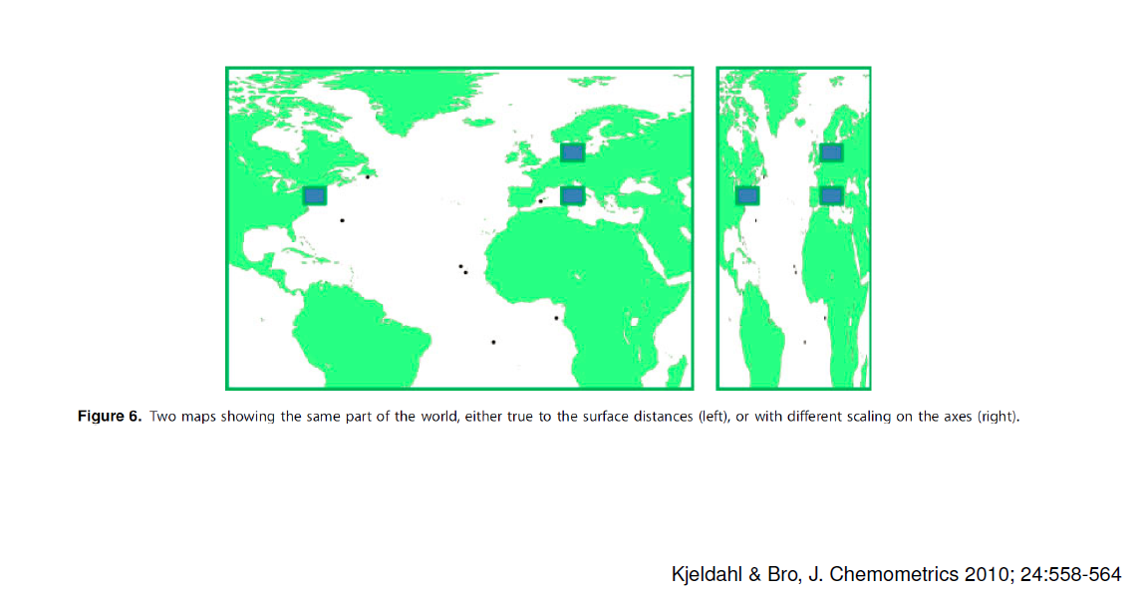
PCA: Pitfalls 4
Scatter plots of scores might be used for spotting clusters and outliers. Make sure that the scaling on the axes are comparable!

Slide 18
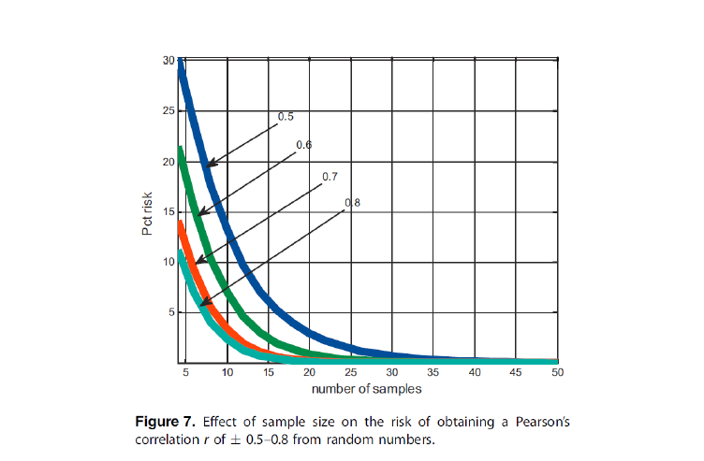
PCA: Pitfalls 5
Don’t trust calculated correlations when samples are few and variables are many.

Slide 19
Remember when doing statistics!
Causality is not the same as an observed correlation!!!!!!
  The correlation is only an observed correlation as the relation between sales of ice cream and the number of drowning accidents, where an underlying factor (the sun) is the direct causal link.
  Keep the aim of the modeling in focus
  Support choices by domain specific knowledge
  Be critical

